Slide 1
Fundamental Concepts of Database Management
www.pdbmbook.com

Slide 2
Introduction
Applications of Database Technology
Key definitions
File versus Database Approach to Data Management
Elements of a Database System
Advantages of Database Systems and Database Management

Slide 3
Applications of Database Technology
Storage and retrieval of traditional numeric and alphanumeric data in an inventory application
Multimedia applications (e.g., YouTube, Spotify)
Biometric applications (e.g., fingerprints, retina scans)
Wearable applications (e.g., FitBit, Apple Watch)
Geographical Information Systems (GIS) applications (e.g., Google Maps)
Sensor applications (e.g., nuclear reactor)
Big Data applications (e.g., Walmart)
Internet of Things (IoT) applications (e.g., Telematics)

Slide 4
Key definitions
A database can be defined as a collection of related data items within a specific business process or problem setting
has a target group of users and applications
A Database Management System (DBMS), is the software package used to define, create, use and maintain a database
consists of several software modules
The combination of a DBMS and a database is then often called a database system

Slide 5
File versus Database Approach to Data Management

Slide 6
File versus Database Approach to Data Management
File approach
duplicate or redundant information will be stored
danger of inconsistent data
strong coupling between applications and data
hard to manage concurrency control
hard to integrate applications aimed at providing cross-company services

Slide 7
File versus Database Approach to Data Management

Slide 8
File versus Database Approach to Data Management
Database approach
superior to the file approach in terms of efficiency, consistency and maintenance
loose coupling between applications and data
facilities provided for data querying and retrieval

Slide 9
File versus Database Approach to Data Management
File approach
Procedure FindCustomer;
begin open file Customer.txt;
Read(Customer)
While not EOF(Customer)
If Customer.name='Bart' then
display(Customer);
EndIf
Read(Customer);
EndWhile;
End;
Database approach (SQL)
SELECT *
FROM Customer
WHERE
name = 'Bart'

Slide 10
Elements of a Database System
Database model versus instances
Data Model
The Three Layer Architecture
Catalog
Database Users
Database Languages

Slide 11
Database model versus instances
Database model or database schema provides the description of the database data at different levels of detail and specifies the various data items, their characteristics and relationships, constraints, storage details, etc.
specified during database design and not expected to change too frequently
stored in the catalog
Database state represents the data in the database at a particular moment
also called the current set of instance
typically changes on an ongoing basis

Slide 12
Database model versus instances
Database model
Student (number, name, address, email)
Course (number, name)
Building (number, address)

Slide 13
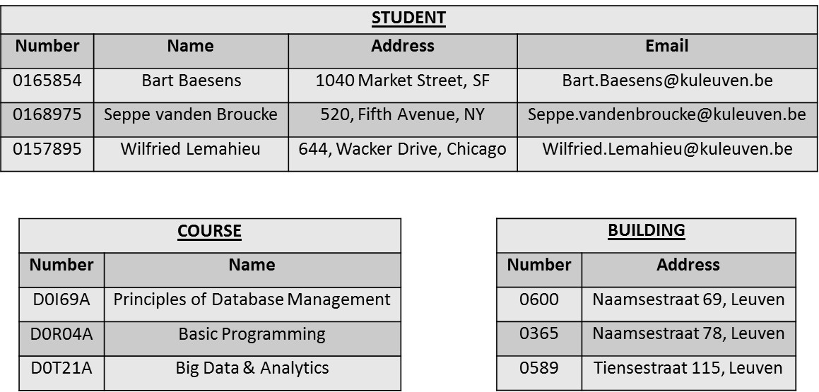
Database model versus instances
Database state

Slide 14
Data Model
A database model is comprised of different data models, each describing the data from different perspectives
A data model provides a clear and unambiguous description of the data items, their relationships and various data constraints from a particular perspective

Slide 15
Data Model
A conceptual data model provides a high-level description of the data items with their characteristics and relationships
communication instrument between information architect and business user
should be implementation independent, user-friendly, and close to how the business user perceives the data
usually represented using an Enhanced-Entity Relationship (EER) model, or an object-oriented model
Logical data model is a translation or mapping of the conceptual data model towards a specific implementation environment
can be a hierarchical, CODASYL, relational, object-oriented, extended relational, XML or NoSQL model

Slide 16
Data Model
Logical data model can be mapped to an internal data model that represents the data’s physical storage details
clearly describes which data is stored where, in what format, which indexes are provided to speed up retrieval, etc.
highly DBMS specific
External data model contains various subsets of the data items in the logical model, also called views, tailored towards the needs of specific applications or groups of users

Slide 17
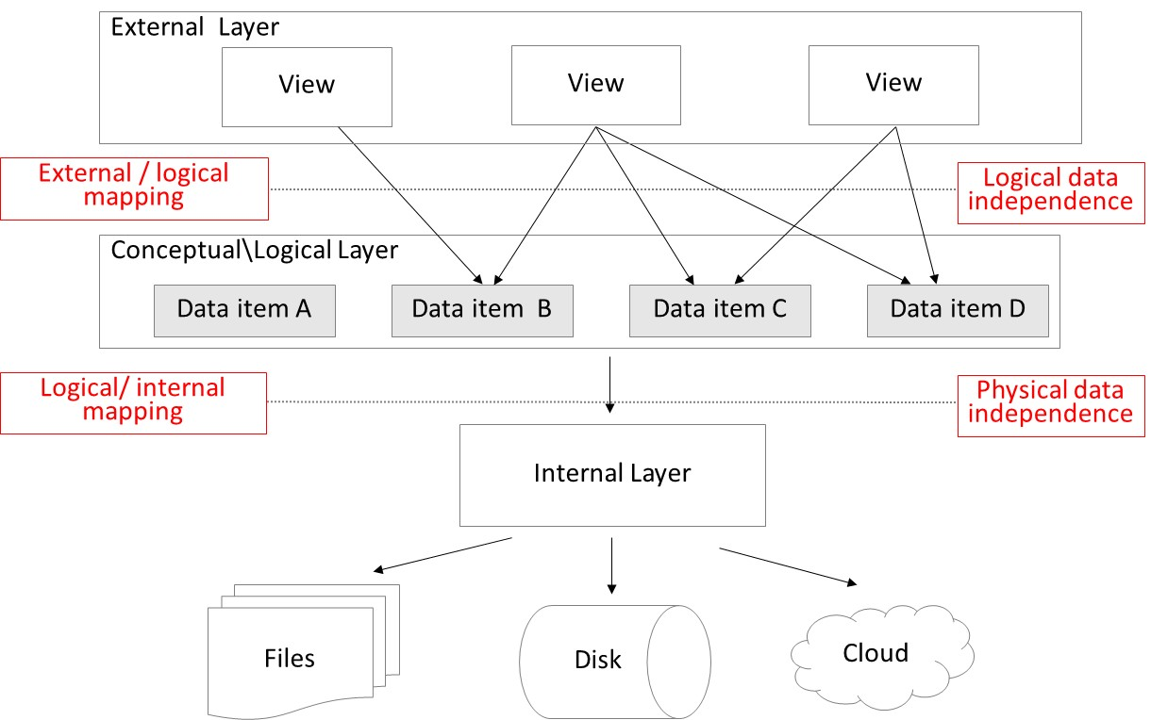
The Three Layer Architecture
physical data + logical data independence!

Slide 18
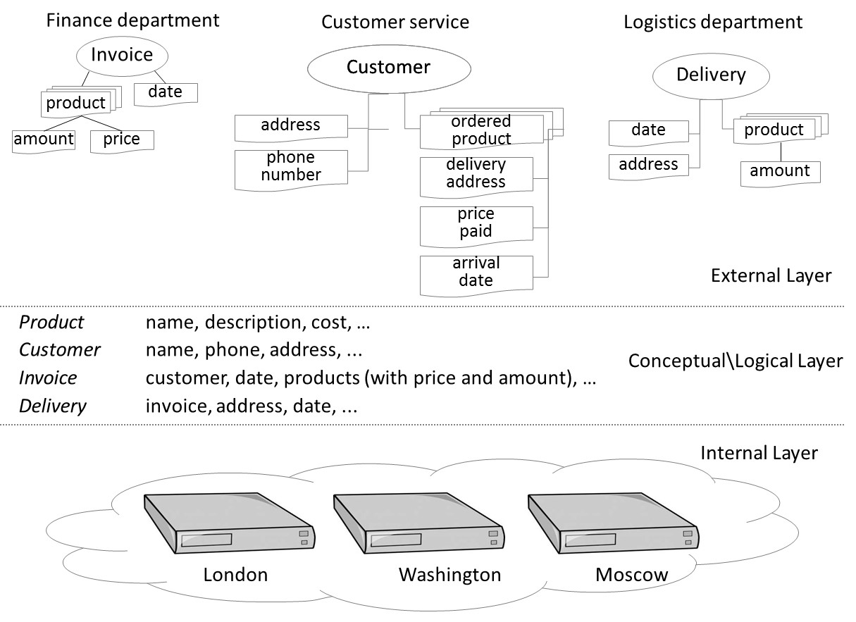
The Three Layer Architecture

Slide 19
Catalog
Heart of the DBMS
Contains the data definitions, or metadata, of your database application
Stores the definitions of the views, logical and internal data models, and synchronizes these three data models to make sure their consistency is guaranteed

Slide 20
Database Users
Information architect designs the conceptual data model
closely interacts with the business user
Database designer translates the conceptual data model into a logical and internal data model
Database administrator (DBA) is responsible for the implementation and monitoring of the database
Application developer develops database applications in a programming language such as Java or Python
Business user will run these applications to perform specific database operations

Slide 21
Database Languages
Data Definition Language (DDL) is used by the DBA to express the database's external, logical and internal data models
definitions are stored in the catalog
Data Manipulation Language (DML) is used to retrieve, insert, delete, and modify data
DML statements can be embedded in a programming language, or entered interactively through a front-end querying tool
Structured Query Language (SQL) offers both DDL and DML statements for relational database systems

Slide 22
Advantages of Database Systems and Database Management
Data Independence
Database Modelling
Managing Structured, Semi-Structured and Unstructured Data
Managing Data Redundancy
Specifying Integrity Rules
Concurrency Control
Backup and Recovery Facilities
Data Security
Performance Utilities

Slide 23
Data Independence
Data independence implies that changes in data definitions have minimal to no impact on the applications
Physical data independence implies that neither the applications, nor the views or logical data model must be changed when changes are made to the data storage specifications in the internal data model
DBMS should provide interfaces between logical and internal data models
Logical data independence implies that software applications are minimally affected by changes in the conceptual or logical data model
views in the external data model will act as a protective shield
DBMS must provide interfaces between conceptual/logical and external layer

Slide 24
Database Modelling
A data model is an explicit representation of the data items together with their characteristics and relationships
A conceptual data model should provide a formal and perfect mapping of the data requirements of the business process and is made in collaboration with the business user
translated into logical and internal data model
Important that a data model’s assumptions and shortcomings are clearly documented

Slide 25
Managing Structured, Semi-Structured and Unstructured Data
Structured data
can be described according to a formal logical data model
ability to express integrity rules and enforce correctness of data
also facilitates searching, processing and analyzing the data
E.g., number, name, address and email of a student
Unstructured data
no finer grained components in a file or series of characters that can be interpreted in a meaningful way by a DBMS or application
E.g., document with biographies of famous NY citizens
Note: volume of unstructured data surpasses that of structured data

Slide 26
Managing Structured, Semi-Structured and Unstructured Data
Semi-structured data
data which does have a certain structure, but the structure may be very irregular or highly volatile
E.g., individual users’ webpages on a social media platform, or resume documents in a human resources database

Slide 27
Managing Data Redundancy
Duplication of data can be desired in distributed environments to improve data retrieval performance
DBMS is now responsible for the management of the redundancy by providing synchronization facilities to safeguard data consistency
Compared to the file approach, the DBMS guarantees correctness of the data without user intervention

Slide 28
Specifying Integrity Rules
Syntactical rules specify how the data should be represented and stored
E.g., customerID is an integer; birthdate should be stored as month, day and year
Semantical rules focus on the semantical correctness or meaning of the data
E.g., customerID is unique; account balance should be > 0; customer cannot be deleted if he/she has pending invoices
Integrity rules are specified as part of the conceptual\logical data model and stored in the catalog
directly enforced by the DBMS instead of applications

Slide 29
Concurrency Control
DBMS has built in facilities to support concurrent or parallel execution of database programs
Key concept is a database transaction
sequence of read/write operations considered to be an atomic unit in the sense that either all operations are executed or none at all
Read/write operations can be executed at the same time by the DBMS
DBMS should avoid inconsistencies!

Slide 30
Concurrency Control
Lost update problem
Time | T1 | T2 | balance
t1 |  | Begin transaction | $100
t2 | Begin transaction | read(balance) | $100
t3 | read(balance) | balance=balance+120 | $100
t4 | balance=balance-50 | write(balance) | $220
t5 | write(balance) | End transaction | $50
t6 | End transaction |  | $50

Slide 31
Concurrency Control
DBMS must support ACID (Atomicity, Consistency, Isolation, Durability) properties
Atomicity requires that a transaction should either be executed in its entirety or not all
Consistency assures that a transaction brings the database from one consistent state to another
Isolation ensures that the effect of concurrent transactions should be the same as if they would have been executed in isolation
Durability ensures that the database changes made by a transaction declared successful can be made permanent under all circumstances

Slide 32
Backup and Recovery Facilities
Backup and recovery facilities can be used to deal with the effect of loss of data due to hardware or network errors, or bugs in system or application software
Backup facilities can either perform a full or incremental backup
Recovery facilities allow to restore the data to a previous state after loss or damage occurred

Slide 33
Data Security
Data security can be enforced by the DBMS
Some users have read access, whilst others have write access to the data (role-based functionality)
E.g., vendor managed inventory (VMI)
Data access can be managed via logins and passwords assigned to users or user accounts
Each account has its own authorization rules that can be stored in the catalog

Slide 34
Performance Utilities
Three KPIs of a DBMS are
response time denoting the time elapsed between issuing a database request and the successful termination thereof
throughput rate representing the transactions a DBMS can process per unit of time
space utilization referring to the space utilized by the DBMS to store both raw data and metadata
DBMSs come with various types of utilities aimed at improving these KPIs
E.g., utilities to distribute and optimize data storage, to tune indexes for faster query execution, to tune queries to improve application performance, or to optimize buffer management

Slide 35
Conclusions
Applications of Database Technology
Key definitions
File versus Database Approach to Data Management
Elements of a Database System
Advantages of Database Systems and Database Management

Slide 36
More information?
www.pdbmbook.com

Slide 37
Architecture and Classification of DBMSs
www.pdbmbook.com

Slide 38
Introduction
Architecture of a DBMS
Categorization of DBMSs

Slide 39
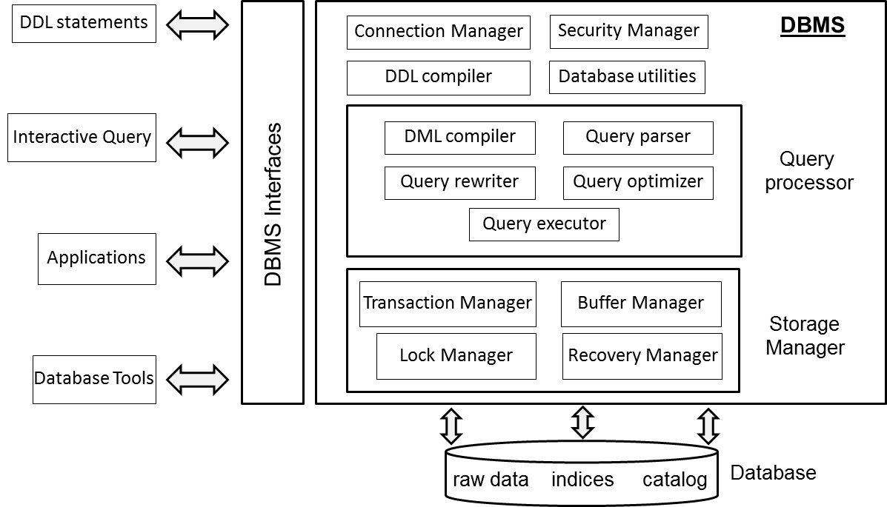
Architecture of a DBMS

Slide 40
Architecture of a DBMS
Connection and Security Manager
DDL Compiler
Query Processor
Storage Manager
DBMS Utilities
DBMS Interfaces

Slide 41
Connection and Security Manager
Connection manager provides facilities to setup a database connection (locally or through a network)
verifies logon credentials and returns a connection handle
database connection can either run as single process or as thread within a process
Security manager verifies whether a user has the right privileges
read versus write access

Slide 42
DDL Compiler
Compiles the data definitions specified in DDL
Ideally 3 DDLs (internal/logical/external data model)
DDL compiler first parses the DDL definitions and checks their syntactical correctness
DDL compiler then translates the data definitions to an internal format and generates errors if required
Upon successful compilation, DDL compiler registers the data definitions in the catalog

Slide 43
Query processor
Query processor assists in the execution of database queries such as retrieval, insertion, update or removal of data
Key components:
DML compiler
Query parser
Query rewriter
Query optimizer
Query executor

Slide 44
DML Compiler
DML compiler compiles the DML statements
Procedural DML
DML explicitly specifies how to navigate in the database
record-at-a-time DML
no query processor
Declarative DML
DML specifies what data should be retrieved or what changes should be made
set-at-a-time DML
query processor

Slide 45
DML Compiler
import java.sql.*;
public class JDBCExample1 {
public static void main(String[] args) {
try {
System.out.println("Loading JDBC driver...");
Class.forName("com.mysql.jdbc.Driver");
System.out.println("JDBC driver loaded!");
} catch (ClassNotFoundException e) {
throw new RuntimeException(e);
}
String url = "jdbc:mysql://localhost:3306/employeeschema";
String username = "root";
String password = "mypassword123";
String query = "select E.Name, D.DName" +
"from employee E, department D" +
"where E.DNR=D.DNR;";
Connection connection = null;
Statement stmt=null;
try {
System.out.println("Connecting to database");
connection = DriverManager.getConnection(url, username, password);
System.out.println("MySQL Database connected!");
stmt = connection.createStatement();
ResultSet rs = stmt.executeQuery(query);
while (rs.next()) {
System.out.print(rs.getString(1));
System.out.print(" ");
System.out.println(rs.getString(2));
}
stmt.close();
} catch (SQLException e) {
System.out.println(e.toString());
} finally {
System.out.println("Closing the connection.");
if (connection != null) {
try {
connection.close();
} catch (SQLException ignore) {}}}}

Slide 46
DML Compiler
Impedance mismatch problem
mapping between OO (e.g. Java) and relational (e.g. SQL) concepts
Impedance mismatch solutions
host language and DBMS with comparable data structures (e.g., Java and OODBMS)
middleware to map the data structures from the DBMS to the host language and vice versa

Slide 47
DML Compiler

Slide 48
DML Compiler
DML compiler starts by extracting the DML statements from the host language.
DML compiler then collaborates with the query parser, query rewriter, query optimizer, and query executor for executing the DML statements
Errors are generated and reported if necessary

Slide 49
Query Parser and Query Rewriter
Query parser parses the query into an internal representation format
Query parser checks the query for syntactical and semantical correctness
Query rewriter optimizes the query, independently of the current database state

Slide 50
Query Optimizer
Query optimizer optimizes the query based upon the current database state (based upon e.g. predefined indexes)
Query optimizer comes up with various query execution plans and evaluates their cost in terms of estimated
number of I/O operations
CPU processing cost
execution time
Estimates based on catalog information combined with statistical inference
Query optimizer is a key competitive asset of a DBMS

Slide 51
Query executor
Result of the query optimization is a final execution plan
Query executor takes care of the actual execution by calling on the storage manager to retrieve the data requested

Slide 52
Storage manager
Storage manager governs physical file access and supervises the correct and efficient storage of data
Storage manager consists of
transaction manager
buffer manager
lock manager
recovery manager

Slide 53
Transaction manager
Transaction manager supervises execution of database transactions
a database transaction is a sequence of read/write operations considered to be an atomic unit
Transaction manager creates a schedule with interleaved read/write operations
Transaction manager guarantees ACID properties
COMMIT a transaction upon successful execution and ROLLBACK a transaction upon unsuccessful execution

Slide 54
Buffer Manager
Buffer manager manages buffer memory of the DBMS
Buffer manager intelligently caches data in the buffer
Example strategies:
Data locality: data recently retrieved is likely to be retrieved again
20/80 law: 80% of the transactions read or write only 20% of the data
Buffer manager needs to adopt smart replacement strategy in case buffer is full
Buffer manager needs to interact with lock manager

Slide 55
Lock Manager
Lock manager provides concurrency control which ensures data integrity at all times
Two types of locks: read and write locks
Lock manager is responsible for assigning, releasing, and recording locks in the catalog
Lock manager makes use of a locking protocol which describes the locking rules, and a lock table with the lock information

Slide 56
Recovery Manager
Recovery manager supervises the correct execution of database transactions
Recovery manager keeps track of all database operations in a log file
Recovery manager will be called upon to undo actions of aborted transactions or during crash recovery

Slide 57
DBMS Utilities
Loading utility
Reorganization utility
Performance monitoring utilities
User management utilities
Backup and recovery utility

Slide 58
DBMS Interfaces
Web-based interface
Stand-alone query language interface
Command line interface
Forms-based interface
Graphical user interface
Natural language interface
Admin interface
Network interface
…

Slide 59
DBMS Interfaces

Slide 60
Categorization of DBMSs
Categorization based on data model
Categorization based on degree of simultaneous access
Categorization based on architecture
Categorization based on usage

Slide 61
Categorization based on data model
Hierarchical DBMSs
adopt a tree like data model
DML is procedural and record oriented
no query processor (logical and internal data model intertwined)
E.g., IMS (IBM)
Network DBMSs
use a network data model
CODASYL DBMSs
DML is procedural and record oriented
no query processor (logical and internal data model intertwined)
CA-IDMS (Computer Associates)

Slide 62
Categorization based on data model
Relational DBMSs
use the relational data model
currently the most popular in industry
SQL (declarative and set oriented)
query processor
strict separation between the logical and internal data model
E.g., MySQL (open source, Oracle), Oracle DBMS (Oracle), DB2 (IBM), Microsoft SQL (Microsoft)

Slide 63
Categorization based on data model
Object-Oriented DBMSs (OODBMS)
based upon the OO data model
No impedance mismatch in combination with OO host language
E.g., db4o (open source, Versant), Caché (Intersystems) GemStone/S (GemTalk Systems)
only successfull in niche markets, due to their complexity

Slide 64
Categorization based on data model
Object-Relational DBMSs (ORDBMSs)
also referred to as extended relational DBMSs (ERDBMSs)
use a relational model extended with OO concepts
DML is SQL (declarative and set oriented)
E.g., Oracle DBMS (Oracle), DB2 (IBM), Microsoft SQL (Microsoft)

Slide 65
Categorization based on data model
XML DBMSs
use the XML data model to store data
Native XML DBMSs (e.g., BaseX, eXist) map the tree structure of an XML document to a physical storage structure
XML-enabled DBMSs (e.g., Oracle, IBM DB2) are existing DBMSs that are extended with facilities to store XML data

Slide 66
Categorization based on data model
NoSQL DBMSs
targeted at storing big and unstructured data
can be classified into key-value stores, column-oriented databases and graph databases
focus on scalability and the ability to cope with irregular or highly volatile data structures
E.g., Apache Hadoop, MongoDB, Neo4j

Slide 67
Categorization based upon degree of simultaneous access
Single user versus multi user systems

Slide 68
Categorization based on architecture
Centralized DBMS architecture
data is maintained on a centralized server
Client server DBMS architecture
active clients request services from passive servers
fat server versus fat client variant
n-tier DBMS architecture
client with GUI functionality, application server with applications, database server with DBMS and database, and web server for web based access

Slide 69
Categorization based on architecture
Cloud DBMS architecture
DBMS and database are hosted by a third-party cloud provider
E.g., Apache Cassandra project and Google’s BigTable
Federated DBMS
provides a uniform interface to multiple underlying data sources
hides the underlying storage details to facilitate data access

Slide 70
Categorization based on architecture
in-memory DBMS
stores all data in internal memory instead of slower external storage (e.g., disk)
often used for real-time purposes
E.g., HANA (SAP)

Slide 71
Categorization based on usage
On-line transaction processing (OLTP)
focus on managing operational or transactional data
database server must be able to process lots of simple transactions per unit of time
DBMS must have good support for processing a high volume of short, simple queries
On-line analytical processing (OLAP)
focus on using operational data for tactical or strategical decision making
limited number of users formulates complex queries
DBMS should support efficient processing of complex queries which often come in smaller volumes

Slide 72
Categorization based on usage
Big Data & Analytics
NoSQL databases
focus on more flexible, or even schema-less, database structures
store unstructured information such as emails, text documents, Twitter tweets, Facebook posts, etc.
Multimedia
Multimedia DBMSs provide storage of multimedia data such as text, images, audio, video, 3D games, etc.
should also provide content-based query facilities

Slide 73
Categorization Based on Usage
Spatial applications
spatial DBMSs support storage and querying of spatial data (both 2D and 3D)
Geographical Information Systems (GIS)
Sensoring
sensor DBMSs manage sensor data such as biometric data from wearables, or telematics data

Slide 74
Categorization based on usage
Mobile
Mobile DBMSs run on smartphones, tablets or other mobile devices.
should always be online, have a small footprint and be able to deal with limited processing power, storage and battery life
Open source
code of open source DBMSs is publicly available and can be extended by anyone
See www.sourceforge.net
E.g., MySQL (Oracle)

Slide 75
Conclusions
Architecture of a DBMS
Categorization of DBMSs

Slide 76
More information?
www.pdbmbook.com

Slide 77
Conceptual Data Modeling using the (E)ER model and UML Class Diagram
www.pdbmbook.com

Slide 78
Overview
Phases of Database Design
Entity Relationship (ER) model
Enhanced Entity Relationship (EER) model
UML Class Diagram

Slide 79
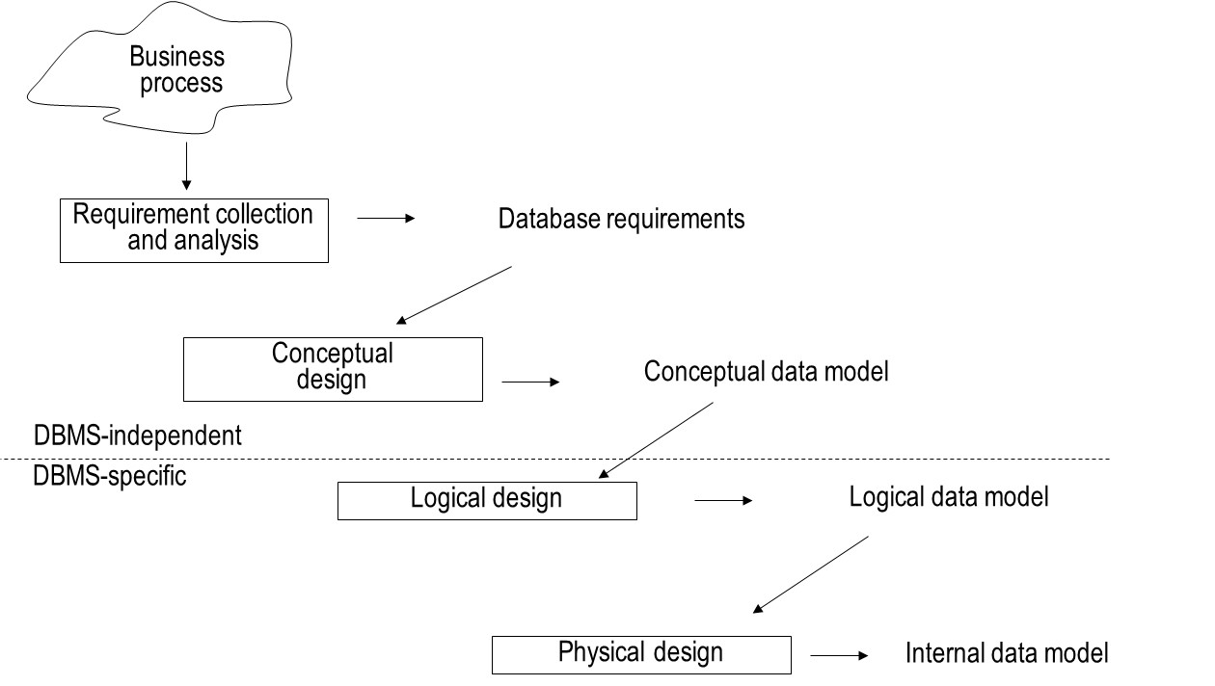
Phases of Database Design

Slide 80
Entity Relationship (ER) model
Entity Types
Attribute Types
Relationship Types
Weak Entity Types
Ternary Relationship Types
Examples of the ER model
Limitations of the ER model

Slide 81

Entity Types
Entity type represents a business concept with an unambiguous meaning to a particular set of users
Examples: supplier, student, product or employee
Entity is one particular occurrence or instance of an entity type
Examples: Deliwines, Best Wines and Ad Fundum are entities from the entity type supplier

Slide 82
Attribute Types
Attribute type represents a property of an entity type.
Example: name and address are attribute types of the entity type supplier
Attribute is an instance of an attribute type

Slide 83
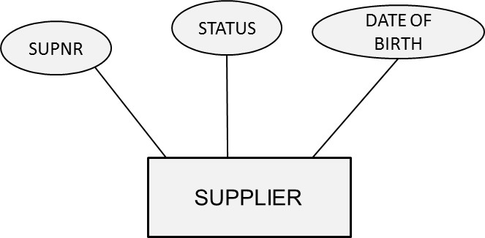
Attribute Types

Slide 84
Attribute Types
Domains
Key Attribute Types
Simple versus Composite Attribute Types
Single-Valued versus Multi-Valued Attribute Types
Derived Attribute Type

Slide 85
Domains
A domain specifies the set of values that may be assigned to an attribute for each individual entity
Example: gender: male and female
A domain can also contain null values
null value: value is not known, not applicable or not relevant
Domains are not displayed in an ER model

Slide 86
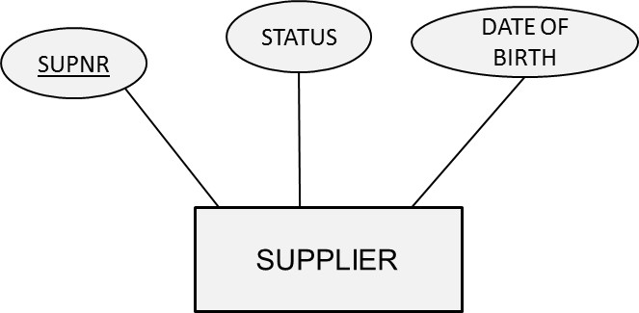
Key Attribute Types
A key attribute type is an attribute type whose values are distinct for each individual entity
Examples: supplier number, product number, social security number
A key attribute type can also be a combination of attribute types
Example: combination of flight number and departure date

Slide 87
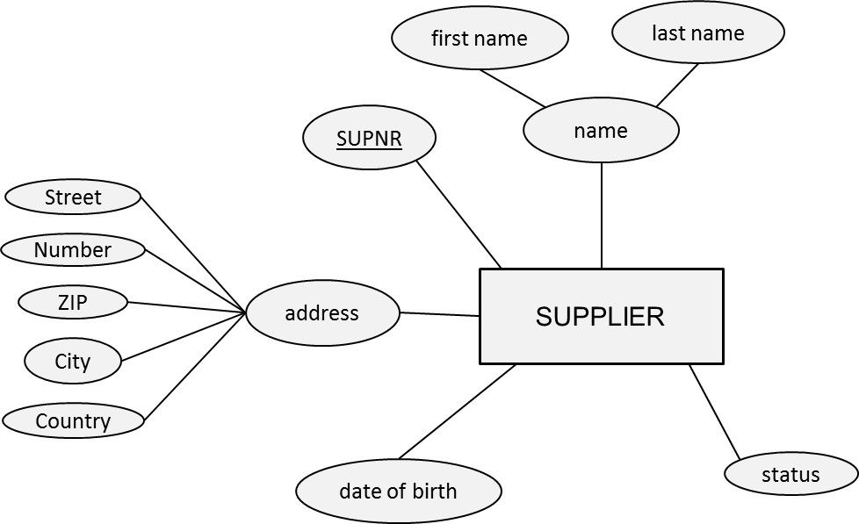
Simple versus Composite Attribute Types
A simple or atomic attribute type cannot be further divided into parts
Examples: supplier number, supplier status
A composite attribute type is an attribute type that can be decomposed into other meaningful attribute types
Examples: address, name

Slide 88
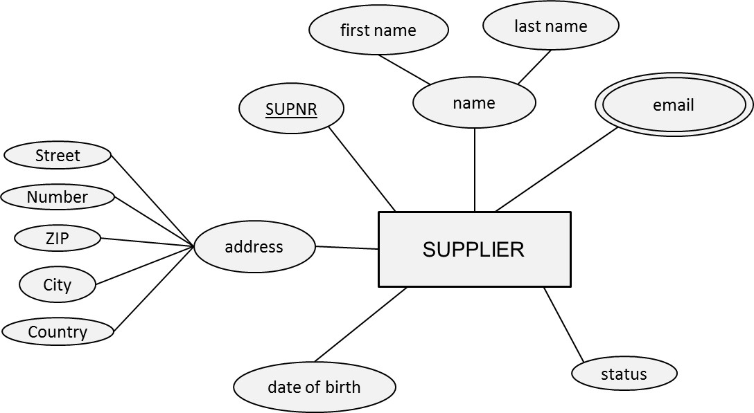
Single-Valued versus Multi-Valued Attribute Types
A single-valued attribute type has only one value for a particular entity
Examples: product number, product name
A multi-valued attribute type is an attribute type that can have multiple values
Example: email address

Slide 89
Derived Attribute Type
A derived attribute type is an attribute type which can be derived from another attribute type
Example: age

Slide 90
Relationship Types
Definition
Degree and Roles
Cardinalities
Relationship Attribute Types

Slide 91
Definition
A relationship represents an association between two or more entities
A relationship type then defines a set of relationships among instances of one, two or more entity types

Slide 92
Degree and Roles
The degree of a relationship type corresponds to the number of entity types participating in the relationship type
Unary: degree 1, binary: degree 2, ternary: degree 3
The roles of a relationship type indicate the various directions that can be used to interpret it

Slide 93
Degree and Roles

Slide 94
Cardinalities
Every relationship type can be characterized in terms of its cardinalities, which specify the minimum or maximum number of relationship instances that an individual entity can participate in
Minimum cardinality can be 0 or 1
If 0: partial participation
If 1: total participation or existence dependency
Maximum cardinality can be 1 or N
Relationship types are often characterized by their maximum cardinalities
4 options for binary relationship types: 1:1, 1:N, N:1 and M:N.

Slide 95
Cardinalities

Slide 96
Relationship Attribute Types
Relationship type can also have attribute types
These attribute types can be migrated to one of the participating entity types in case of a 1:1 or 1:N relationship type

Slide 97
Weak Entity Type
A strong entity type is an entity type that has a key attribute type
A weak entity type is an entity type that does not have a key attribute type of its own
related to owner entity type from which it borrows an attribute type to make up a key attribute type

Slide 98
Weak Entity Type
Weak entity type is always existent dependent from owner entity type (not vice versa!)

Slide 99
Ternary Relationship Types
Assume that we have a situation where suppliers can supply products for projects. A supplier can supply a particular product for multiple projects. A product for a particular project can be supplied by multiple suppliers. A project can have a particular supplier supply multiple products. The model must also include the quantity and due date for supplying a particular product to a particular project by a particular supplier.

Slide 100
Ternary Relationship Types
Note: loss of semantics!

Slide 101
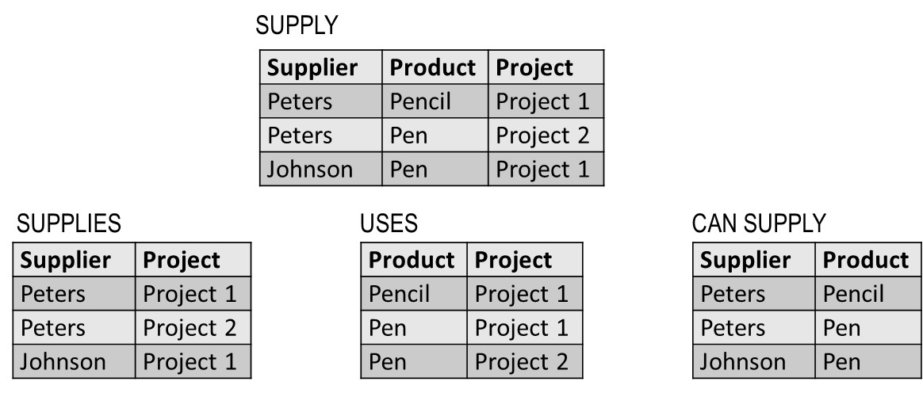
Ternary Relationship Types
Say we have two projects: project 1 uses a pencil and a pen, and project 2 uses a pen. Supplier Peters supplies the pencil for project 1 and the pen for project 2 whereas supplier Johnson supplies the pen for project 1.
From the binary relationship types, it is not clear who supplies the pen for project 1!

Slide 102
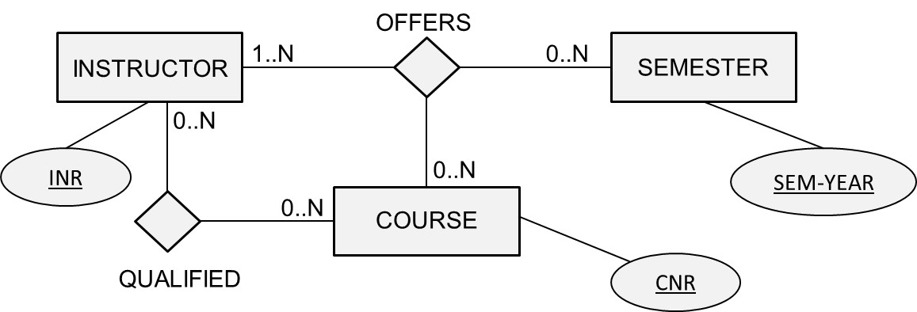
Ternary Relationship Types

Slide 103
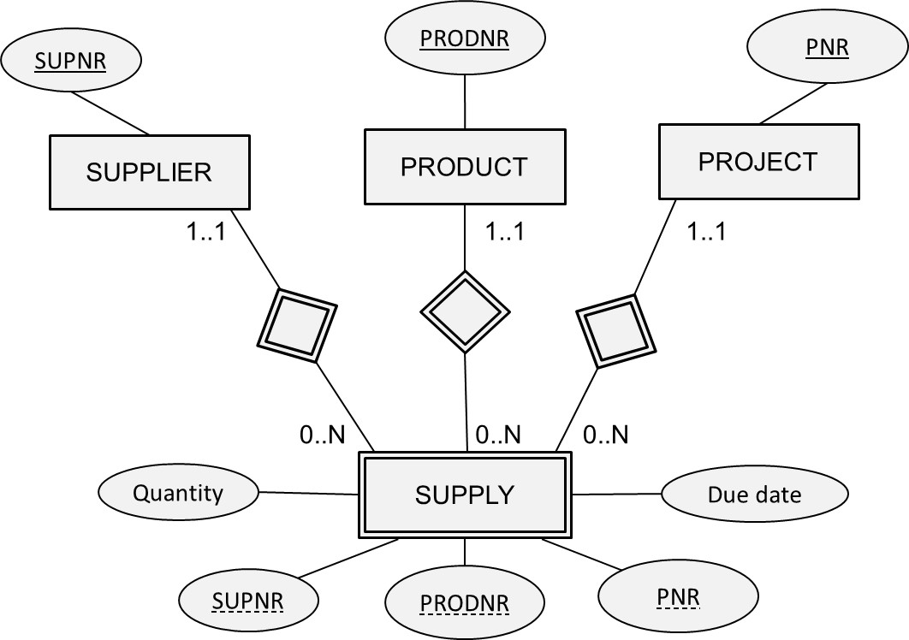
Ternary Relationship Types

Slide 104
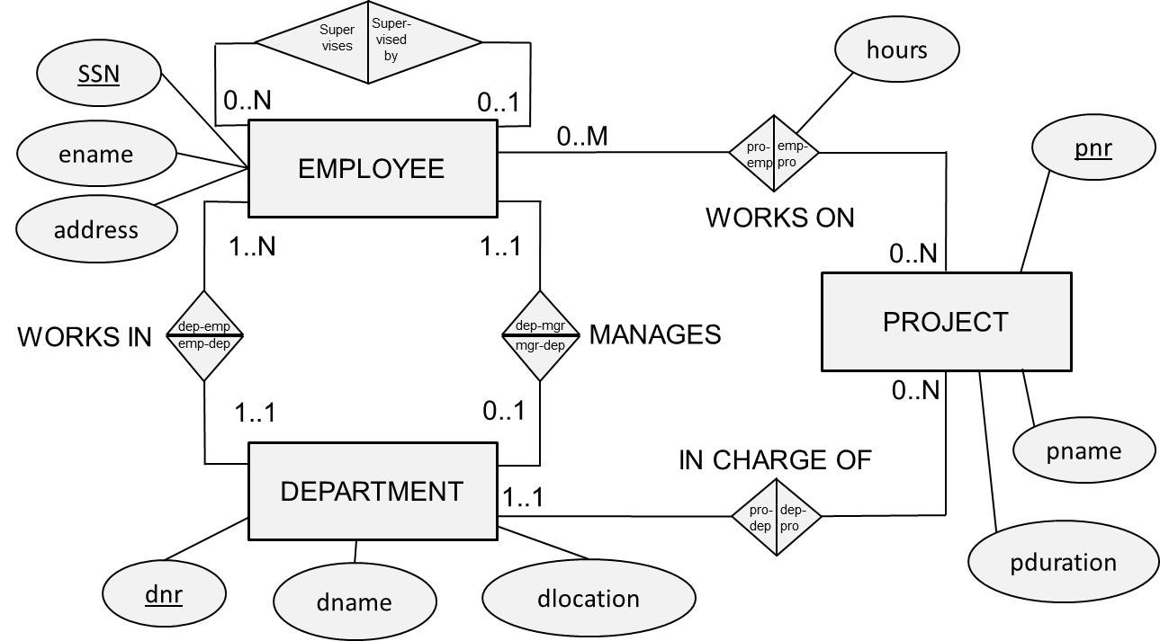
Examples of the ER Model

Slide 105
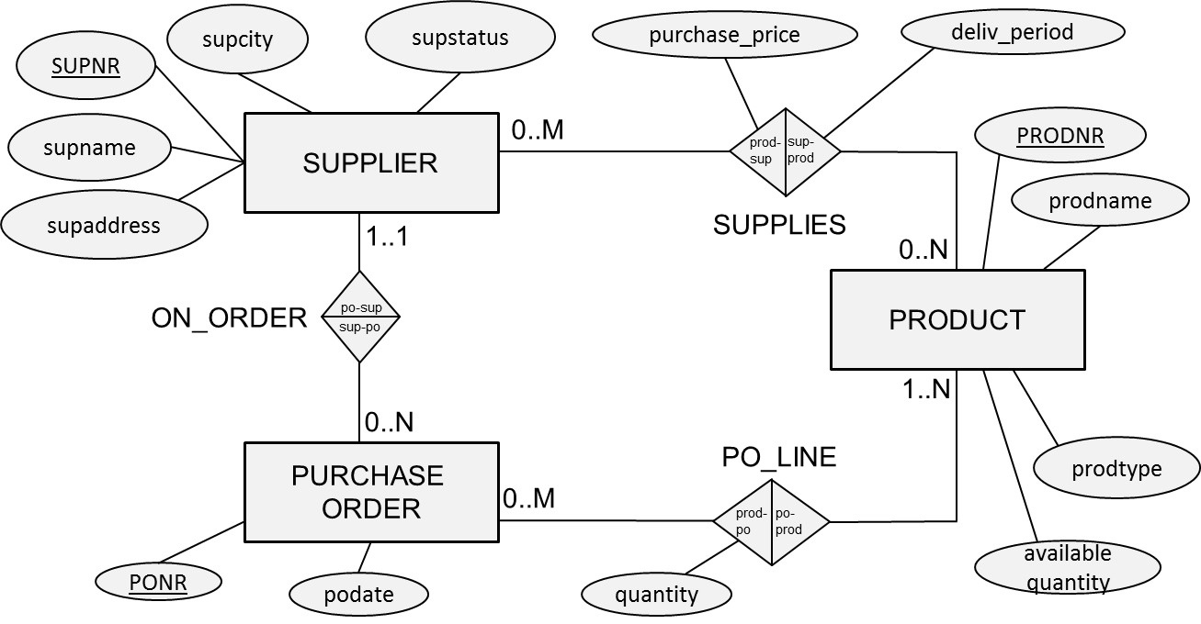
Examples of the ER Model

Slide 106
Limitations of the ER model
ER model presents a temporary snapshot and cannot model temporal constraints
Examples: a project needs to be assigned to a department after one month, an employee cannot return to a department of which he previously was a manager, a purchase order must be assigned to a supplier after two weeks, etc.
ER model cannot guarantee the consistency across multiple relationship types
Examples: an employee should work in the department that he/she manages, employees should work on projects assigned to departments to which the employees belong, suppliers can only be assigned to purchase orders for products they can supply

Slide 107
Limitations of the ER model
Domains are not included in the ER model
Examples: hours should be positive; prodtype must be red, white or sparkling, supstatus is an integer between 0 and 100
Functions are not included in the ER model
Examples: calculate average number of projects an employee works on; determine which supplier charges the maximum price for a product

Slide 108
Enhanced Entity Relationship (EER) Model
Specialization/Generalization
Categorization
Aggregation
Examples of the EER Model
Designing the EER Model

Slide 109
Specialization/Generalization
Specialization refers to the process of defining a set of subclasses of an entity type
Example: ARTIST superclass with subclasses SINGER and ACTOR
The specialization process defines an “IS A” relationship
The specialization can then establish additional specific attribute types for each subclass
Example: singer can have a music style attribute type
The specialization can also establish additional specific relationship types for each subclass
Examples: actor can act in movies, singer can be part of a band
A subclass inherits all attribute types and relationship types from its superclass

Slide 110
Specialization/Generalization
Generalization, also called abstraction, is the reverse process of specialization
Specialization corresponds to a top-down process of conceptual refinement
Generalization corresponds to a bottom-up process of conceptual synthesis

Slide 111
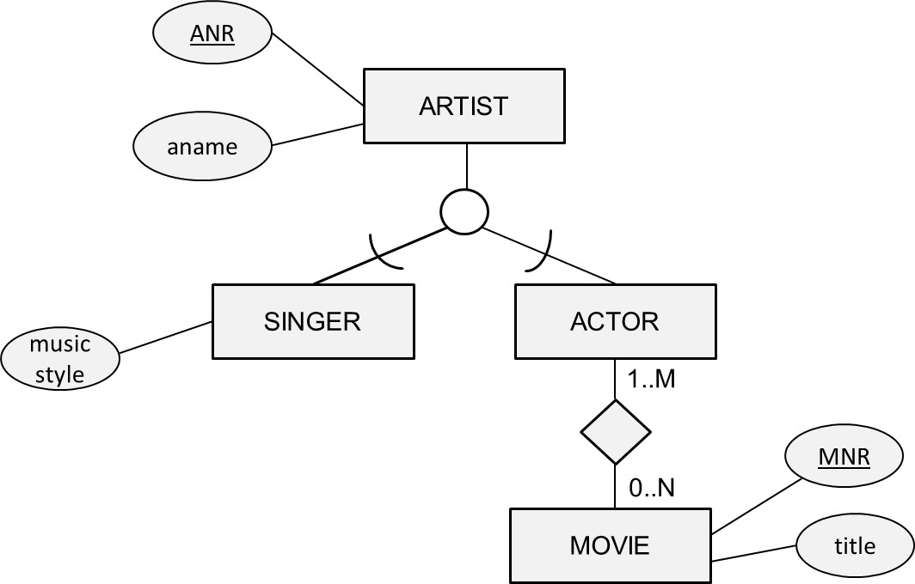
Specialization/Generalization

Slide 112
Specialization/Generalization
The disjointness constraint specifies to what subclasses an entity of the superclass can belong to
A disjoint specialization is a specialization whereby an entity can be a member of at most one of the subclasses
An overlap specialization is a specialization whereby the same entity may be a member of more than one subclass
The completeness constraint indicates if all entities of the superclass should belong to one of the subclasses or not
A total specialization is a specialization whereby every entity in the superclass must be a member of some subclass
A partial specialization allows an entity to only belong to the superclass and to none of the subclasses

Slide 113
Specialization/Generalization

Slide 114
Specialization/Generalization

Slide 115
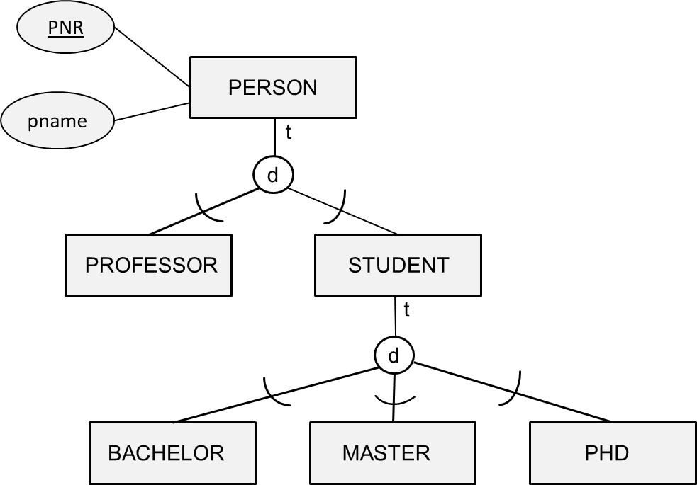
Specialization/Generalization
In a specialization hierarchy, every subclass can only have a single superclass and inherits the attribute types and relationship types of all its predecessor superclasses all the way up to the root of the hierarchy

Slide 116
Specialization/Generalization
In a specialization lattice, a subclass can have multiple superclasses (multiple inheritance)

Slide 117
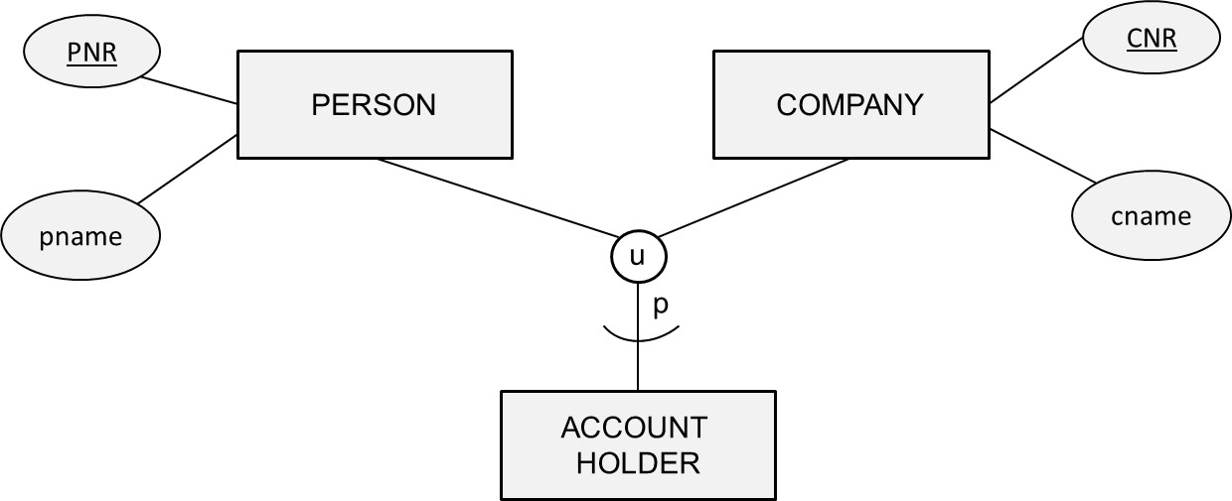
Categorization
A category is a subclass that has several possible superclasses
Each superclass represents a different entity type
The category represents a collection of entities that is a subset of the union of the superclasses

Slide 118
Categorization
Inheritance in the case of categorization corresponds to an entity inheriting only the attributes and relationships of that superclass it is a member of (selective inheritance)
A categorization can be total or partial
Total: all entities of the superclasses belong to the subclass
Partial: not all entities of the superclasses belong to the subclass
Note: total categorization can also be represented as a specialization/generalization!

Slide 119
Aggregation
Entity types that are related by a particular relationship type can be combined or aggregated into a higher-level aggregate entity type
Aggregation is especially useful when the aggregate entity type has its own attribute types and/or relationship types

Slide 120
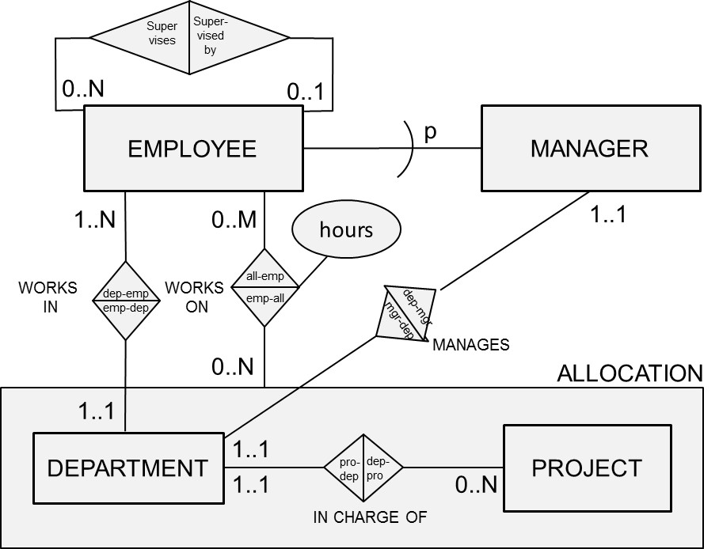
Examples of the EER Model

Slide 121
Designing the EER Model
Identify the entity types
Identify the relationship types and assert their degree
Assert the cardinality ratios and participation constraints (total versus partial participation)
Identify the attribute types and assert whether they are simple or composite, single or multiple valued, derived or not
Link each attribute type to an entity type or a relationship type
Denote the key attribute type(s) of each entity type
Identify the weak entity types and their partial keys
Apply abstractions such as generalization/specialization, categorization and aggregation
Assert the characteristics of each abstraction such as disjoint or overlapping, total or partial

Slide 122
UML Class Diagram
Origin
Recap of Object Orientation
Classes
Variables
Access Modifiers
Associations
Specialization/Generalization
Aggregation
UML Class Diagram Example
Advanced UML Modeling Concepts
UML Class Diagram versus EER

Slide 123
Origin
The Unified Modeling Language (UML) is a modeling language which assists in the specification, visualization, construction and documentation of artifacts of a software system
UML was accepted as a standard by the Object Management Group (OMG) in 1997 and approved as an ISO standard in 2005
Most recent version is UML 2.5, introduced in 2015
UML offers various diagrams such as use case diagrams, sequence diagrams, package diagrams, deployment diagrams, etc.
From a database modeling perspective, the class diagram is the most important

Slide 124
Recap of Object Orientation
A class is a blueprint definition for a set of objects
Compare to entity type in ER
Conversely, an object is an instance of a class
Compare to entity in ER
Object is characterized by both variables and methods
Variables correspond to attribute types and variable values to attributes in the ER
No ER equivalent for methods

Slide 125
Recap of Object Orientation
Example class Student
Objects: Bart, Wilfried, Seppe
Example variables: student’s name, gender and birthdate
Example methods: calcAge, isBirthday, hasPassed(courseID)
Information hiding (a.k.a. encapsulation) states that the variables of an object can only be accessed through either getter or setter methods
getter method is used to retrieve the value of a variable
setter method assigns a value to a it

Slide 126
Recap of Object Orientation
Inheritance
A superclass can have one or more subclasses which inherit both the variables and methods from the superclass
Method overloading
Various methods in the same class can have the same name, but a different number or type of input arguments

Slide 127
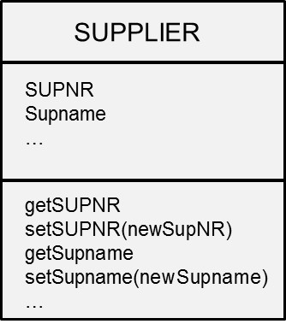
Classes

Slide 128
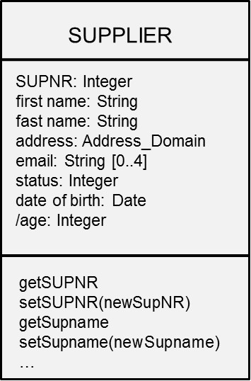
Variables
Variables with unique values (~ key attribute types in ER) are not directly supported in UML
UML provides a set of primitive types such as String, Integer, and Boolean
It is also possible to define your own data types or domains
Composite/Multi-valued/Derived variables

Slide 129
Access Modifiers
Access modifiers can be used to specify who can have access to a variable or method
Three types
private (denoted by ‘–‘): variable or method can only be accessed by the class itself
public (denoted by ‘+’): variable or method can be accessed by any other class
protected (denoted by ‘#’): variable or method can be accessed by both the class and its subclasses
It is recommended to declare all variables as private (information hiding)

Slide 130
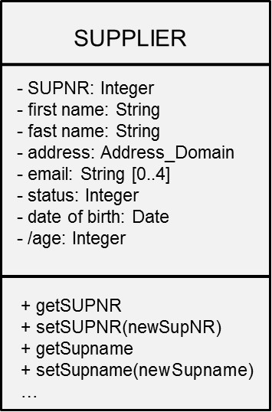
Access Modifiers

Slide 131
Associations
An association corresponds to a relationship type in ER
Multiple associations can be defined between the same classes
A particular occurrence of an association is referred to as a link
An association is characterized by its multiplicities (cardinalities in the ER model)

Slide 132
Associations
UML class diagram multiplicity | ER model cardinality
* | 0..N
0..1 | 0..1
1..* | 1..N
1 | 1..1

Slide 133
Associations
Association Class
Unidirectional versus Bidirectional Association
Qualified Association

Slide 134
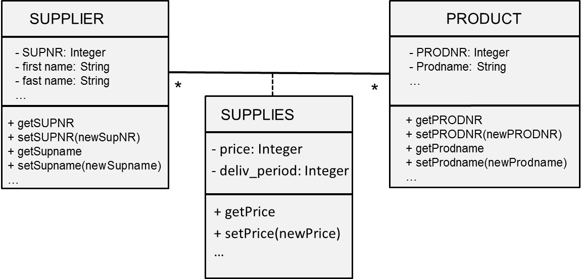
Association Class
In case an association has variables and/or methods on its own, it can be modelled as an association class

Slide 135
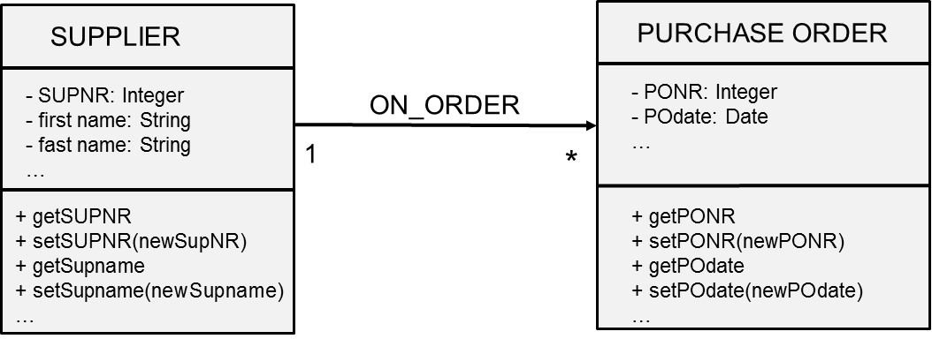
Unidirectional versus Bidirectional Association
Associations can be augmented with direction reading arrows, which specify the direction of querying or navigating through it
Unidirectional
Bidirectional

Slide 136
Qualified Association
A qualified association is a special type of association that uses a qualifier to further refine the association
The qualifier specifies one or more variables that are used as index key for navigating from the qualified class to the target class
reduces the multiplicity of the association because of this extra key

Slide 137
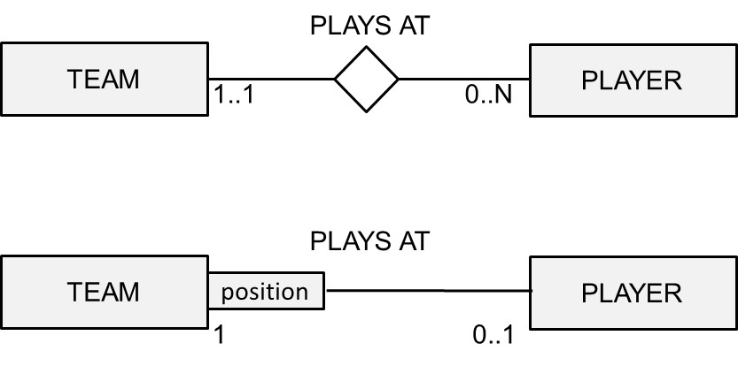
Qualified Association

Slide 138
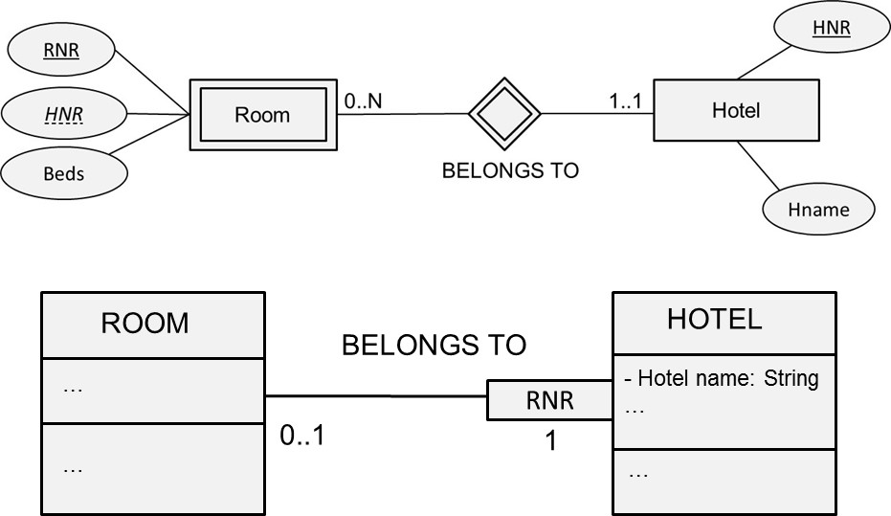
Qualified Association
Qualified associations can be used to represent weak entity types

Slide 139
Specialization/Generalization

Slide 140
Aggregation
Aggregation represents a composite to part relationship whereby a composite class contains a part class
Two types in UML: shared and composite aggregation
Shared aggregation (a.k.a. aggregation)
part object can simultaneously belong to multiple composite objects
maximum multiplicity at the composite side is undetermined
part object can also occur without belonging to a composite object
loose coupling

Slide 141
Aggregation
Composite aggregation (a.k.a. composition)
the part object can only belong to one composite
maximum multiplicity at the composite side is 1
minimum multiplicity can be either 1 or 0
tight coupling

Slide 142
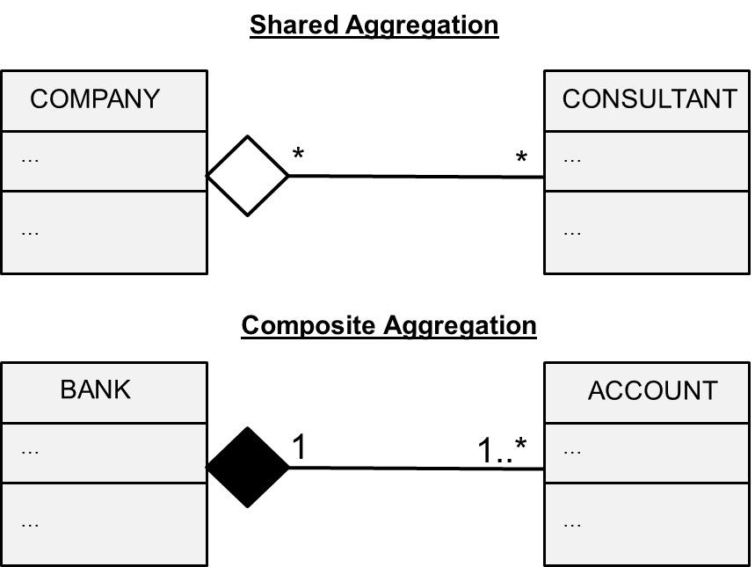
Aggregation

Slide 143
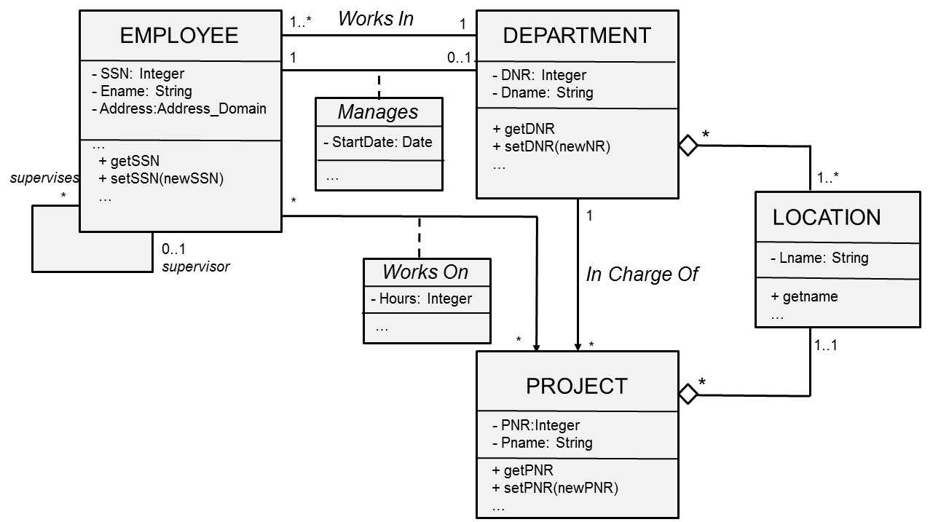
UML Example

Slide 144
Advanced UML Modeling Concepts
Changeability property
Object Constraint Language (OCL)
Dependency relationship

Slide 145
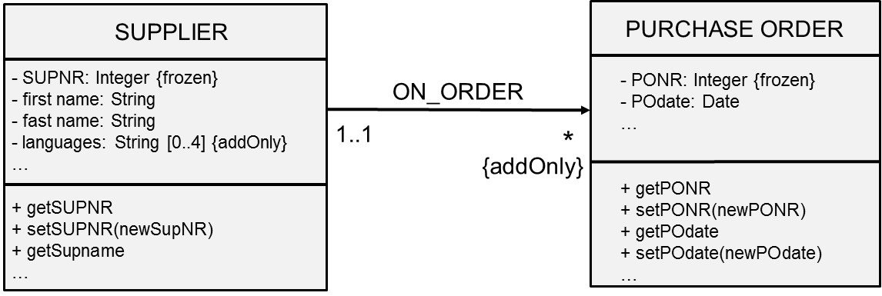
Changeability property
The changeability property specifies the type of operations which are allowed on either variable values or links
Three common choices
default which allows any type of edit
addOnly which only allows additional values or links to be added (so no deletions)
frozen which allows no further changes once the value or link is established

Slide 146
Object Constraint Language (OCL)
The Object Constraint Language (OCL) can be used to specify various types of constraints in a declarative way
no control flow or procedural code is provided
can be used to specify invariants for classes, pre- and post-conditions for methods, to navigate between classes, or to define constraints on operations
See http://www.omg.org/spec/OCL/

Slide 147
Object Constraint Language (OCL)
A class invariant is a constraint which holds for all objects of a class
Example: SUPPLIER: SUPSTATUS>100
Pre- and post-conditions on methods must be true when a method either begins or ends
Example: before the method withdrawal can be executed, the balance must be positive. After it has been executed, the balance must still be positive.

Slide 148
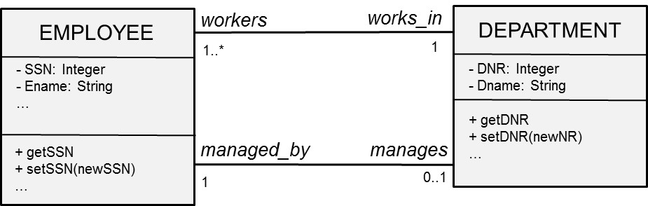
Object Constraint Language (OCL)
Constraint: manager of a department should be at least 10 years employed
Context: Department
invariant: self.managed_by.yearsemployed>10

Slide 149
Object Constraint Language (OCL)
A department should have at least 20 employees.
Context: Department
invariant: self.workers→size()>20

Slide 150
Object Constraint Language (OCL)
Constraint: A manager of a department must also work in the department
Context: Department
Invariant: self.managed_by.works_in=self

Slide 151
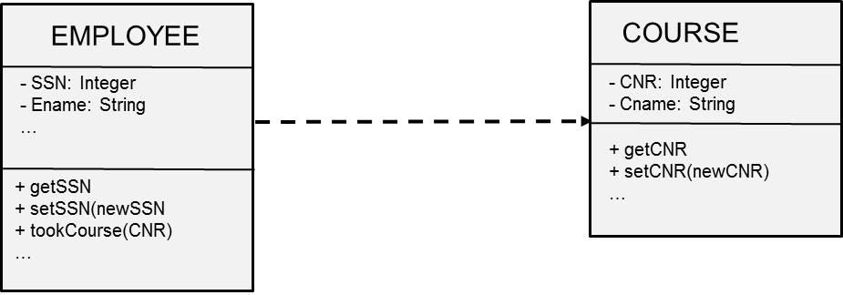
Dependency Relationship
Dependency defines a ‘using’ relationship which states that a change in the specification of a UML modeling concept may affect another modeling concept that uses it

Slide 152
UML Class Diagram versus EER
UML class diagram | EER model
Class | Entity type
Object | Entity
Variable | Attribute type
Variable value | Attribute
Method | -
Association | Relationship type
Link | Relationship

Slide 153
UML versus EER
UML class diagram |  | EER model
Qualified Association |  | Weak entity type
Specialisation/Generalisation |  | Specialisation/Generalisation
Aggregation |  | Aggregation (Composite/Shared)
OCL |  | -
Multiplicity | * | Cardinality | 0..N
 | 0..1 |  | 0..1
 | 1..* |  | 1..N
 | 1 |  | 1..1

Slide 154
Conclusions
Phases of Database Design
Entity Relationship (ER) model
Enhanced Entity Relationship (EER) model
UML Class Diagram

Slide 155
More information?
www.pdbmbook.com

Slide 156
Relational Databases
www.pdbmbook.com

Slide 157
Introduction
Relational Model
Normalization
Mapping a conceptual ER model to a relational model
Mapping a conceptual EER model to a relational model

Slide 158
Relational Model
Basic Concepts
Formal Definitions
Types of Keys
Relational Constraints
Example Relational Model

Slide 159
Basic Concepts
Relational model was first formalized by Edgar F. Codd in 1970
Relational model is a formal data model with a sound mathematical foundation, based on set theory and first order predicate logic
No graphical representation
Commonly adopted to build both logical and internal data models
Microsoft SQL Server, IBM DB2 and Oracle

Slide 160
Basic Concepts
A database is represented as a collection of relations
A relation is defined as a set of tuples that each represent a similar real world entity
A tuple is an ordered list of attribute values that each describe an aspect of an entity

Slide 161
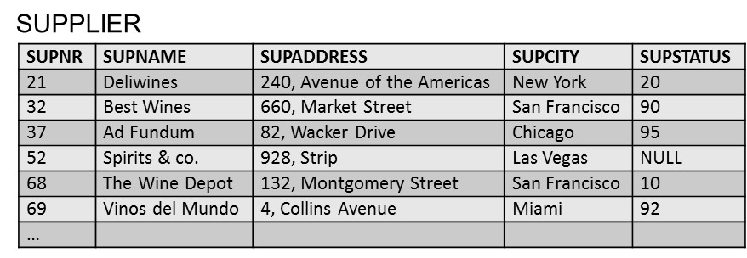
Basic Concepts

Slide 162
Basic Concepts
EER model | Relational Model
Entity type | Relation
Entity | Tuple
Attribute type | Column name
Attribute | Cell

Slide 163
Basic Concepts
Student (Studentnr, Name, HomePhone, Address)
Professor (SSN, Name, HomePhone, OfficePhone, E-mail)
Course (CourseNo, CourseName)

Slide 164
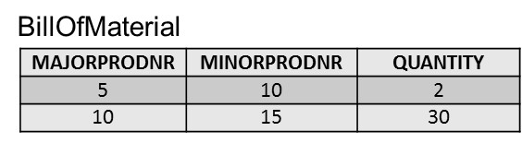
Formal Definitions
A domain specifies the range of admissible values for an attribute type
Example: gender domain, time domain
Each attribute type is defined using a corresponding domain
A domain can be used multiple times in a relation

Slide 165
Formal Definitions
A relation R(A₁, A₂, A₃,… A_{n}) can now be formally defined as a set of m tuples r = {t₁, t₂, t₃,… t_{m}} whereby each tuple t is an ordered list of n values t = <v₁, v₂, v₃,… v_{n}> corresponding to a particular entity
each value v_{i} is an element of the corresponding domain, dom(A_{i}), or is a special NULL value
NULL value means that the value is missing, irrelevant or not applicable

Slide 166
Formal Definitions
Student(100, Michael Johnson, 123 456 789, 532 Seventh Avenue)
Professor(50, Bart Baesens, NULL, 876 543 210, Bart.Baesens@kuleuven.be)
Course(10, Principles of Database Management)

Slide 167
Formal Definitions
A relation essentially represents a set (no ordering + no duplicates!)
The domain constraint states that the value of each attribute type A must be an atomic and single value from the domain dom(A)
Example: COURSE(coursenr, coursename, study points)
(10, Principles of Database Management, 6)
(10, {Principles of Database Management, Database Modeling}, 6) ➔ WRONG!

Slide 168
Formal Definitions
A relation R of degree n on the domains dom(A₁), dom(A₂), dom(A₃), … , dom(A_{n}) can also be alternatively defined as a subset of the Cartesian product of the domains that define each of the attribute types

Slide 169
Types of Keys
Superkeys and Keys
Candidate Keys, Primary Keys, Alternative Keys
Foreign Keys

Slide 170
Superkeys and Keys
A superkey is defined as a subset of attribute types of a relation R with the property that no two tuples in any relation state should have the same combination of values for these attribute types
A superkey specifies a uniqueness constraint
A superkey can have redundant attribute types
Example: (Studentnr, Name, HomePhone)

Slide 171
Superkeys and Keys
A key K of a relation scheme R is a superkey of R with the additional property that removing any attribute type from K leaves a set of attribute types that is no superkey of R
A key does not have any redundant attribute types (minimal superkey)
Example: Studentnr
The key constraint states that every relation must have at least 1 key that allows to uniquely identify its tuples

Slide 172
Candidate Keys, Primary Keys and Alternative Keys
A relation may have more than one key (candidate keys)
PRODUCT: product number and product name
Primary key is used to identify tuples in the relation, to establish connections to other relations and for storage purposes
Entity integrity constraint: attribute types that make up the primary key should always satisfy a NOT NULL constraint
Other candidate keys are then referred to as alternative keys

Slide 173
Foreign Keys
A set of attribute types FK in a relation R₁ is a foreign key of R₁ if two conditions are satisfied (referential integrity constraint)
the attribute types in FK have the same domains as the primary key attribute types PK of a relation R₂
a value FK in a tuple t₁ of the current state r₁ either occurs as a value of PK for some tuple t₂ in the current state r₂ or is NULL

Slide 174
Foreign Keys

Slide 175
Foreign Keys

Slide 176
Foreign Keys

Slide 177
Relational Constraints
Domain constraint | The value of each attribute type A must be an atomic and single value from the domain dom(A).
Key constraint | Every relation has a key that allows to uniquely identify its tuples.
Entity integrity constraint | The attribute types that make up the primary key should always satisfy a NOT NULL constraint.
Referential integrity constraint | A foreign key FK has the same domain as the primary key PK attribute type(s) it refers to and either occurs as a value of PK or NULL.

Slide 178
Example Relational Data Model
SUPPLIER(SUPNR, SUPNAME, SUPADDRESS, SUPCITY, SUPSTATUS)
PRODUCT(PRODNR, PRODNAME, PRODTYPE, AVAILABLE QUANTITY)
SUPPLIES(SUPNR, PRODNR, PURCHASE_PRICE, DELIV_PERIOD)
PURCHASE_ORDER(PONR, PODATE, SUPNR)
PO_LINE(PONR, PRODNR, QUANTITY)

Slide 179
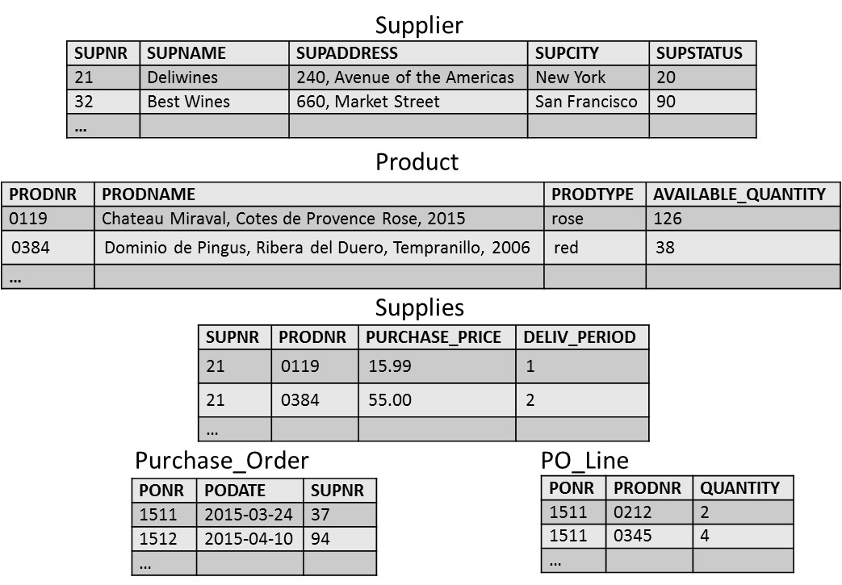
Example Relational Data Model

Slide 180
Normalization
Insertion, Deletion and Update Anomalies
Informal Normalization guidelines
Functional Dependencies and Prime Attribute Type
Normalization forms

Slide 181
Insertion, Deletion and Update Anomalies

Slide 182
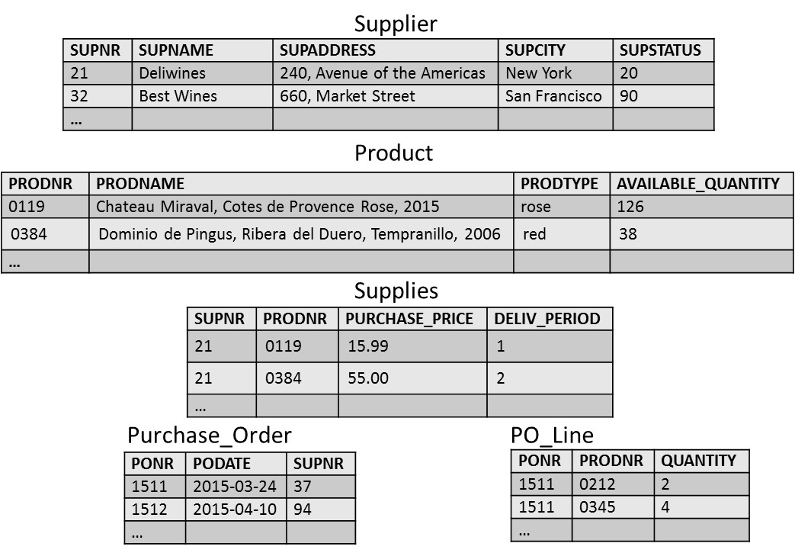
Insertion, Deletion and Update Anomalies

Slide 183
Insertion, Deletion and Update Anomalies
To have a good relational data model, all relations in the model should be normalized
A formal normalization procedure can be applied to transform an unnormalized relational model into a normalized form.
The advantages are twofold:
At the logical level, the users can easily understand the meaning of the data and formulate correct queries
At the implementation level, the storage space is used efficiently and the risk of inconsistent updates is reduced

Slide 184
Informal Normalization Guidelines
Design a relational model in such a way that it is easy to explain its meaning
MYRELATION123(SUPNR, SUPNAME, SUPTWITTER, PRODNR, PRODNAME, …) versus SUPPLIER(SUPNR, SUPNAME, SUPTWITTER, PRODNR, PRODNAME, ……)
Attribute types from multiple entity types should not be combined in a single relation
Avoid excessive amount of NULL values in a relation
SUPPLIER(SUPNR, SUPNAME, …)
SUPPLIER-TWITTER(SUPNR, SUPTWITTER)

Slide 185
Functional Dependencies and Prime Attribute Type
A functional dependency X → Y, between two sets of attribute types X and Y implies that a value of X uniquely determines a value of Y
there is a functional dependency from X to Y or Y is functionally dependent on X
Examples:
SSN → ENAME
PNUMBER → {PNAME, PLOCATION}
{SSN, PNUMBER} → HOURS

Slide 186
Functional Dependencies and Prime Attribute Type
A prime attribute type is an attribute type that is part of a candidate key
Example: R1(SSN, PNUMBER, PNAME, HOURS)
Prime attribute types: SSN and PNUMBER
Non-prime attribute types: PNAME and HOURS

Slide 187
Normalization Forms
First Normal Form (1 NF)
Second Normal Form (2 NF)
Third Normal Form (3 NF)
Boyce-Codd Normal Form (BCNF)
Fourth Normal Form (4 NF)

Slide 188
First Normal Form (1 NF)
The first normal form (1 NF) states that every attribute type of a relation must be atomic and single valued
no composite or multivalued attribute types (domain constraint!)
SUPPLIER(SUPNR, NAME(FIRST NAME, LAST NAME), SUPSTATUS)
SUPPLIER(SUPNR, FIRST NAME, LAST NAME, SUPSTATUS)

Slide 189
First Normal Form (1 NF)
DEPARTMENT(DNUMBER, DLOCATION, DMGRSSN)
Assumption: a department can have multiple locations and multiple departments are possible at a given location
DEPARTMENT(DNUMBER, DMGRSSN)
DEP-LOCATION(DNUMBER, DLOCATION)

Slide 190
First Normal Form (1 NF)

Slide 191
First Normal Form (1 NF)
R1(SSN, ENAME, DNUMBER, DNAME, PROJECT(PNUMBER, PNAME, HOURS))
assume an employee can work on multiple projects and multiple employees can work on the same project
R11(SSN, ENAME, DNUMBER, DNAME)
R12(SSN, PNUMBER, PNAME, HOURS)

Slide 192
Second Normal Form (2 NF)
A functional dependency X → Y is a full functional dependency if removal of any attribute type A from X means that the dependency does not hold anymore
Examples: SSN, PNUMBER → HOURS; PNUMBER → PNAME
A functional dependency X → Y is a partial dependency if an attribute type A from X can be removed from X and the dependency still holds
Example: SSN, PNUMBER → PNAME

Slide 193
Second Normal Form (2 NF)
A relation R is in the second normal form (2 NF) if it satisfies 1 NF and every non-prime attribute type A in R is fully functional dependent on any key of R
If the relation is not in second normal form, we must:
decompose it and set up a new relation for each partial key together with its dependent attribute types
keep a relation with the original primary key and any attribute types that are fully functional dependent on it

Slide 194
Second Normal Form (2 NF)
R1(SSN, PNUMBER, PNAME, HOURS)
assume an employee can work on multiple projects; multiple employees can work on the same project and a project has a unique name
R11(SSN, PNUMBER, HOURS)
R12(PNUMBER, PNAME)

Slide 195
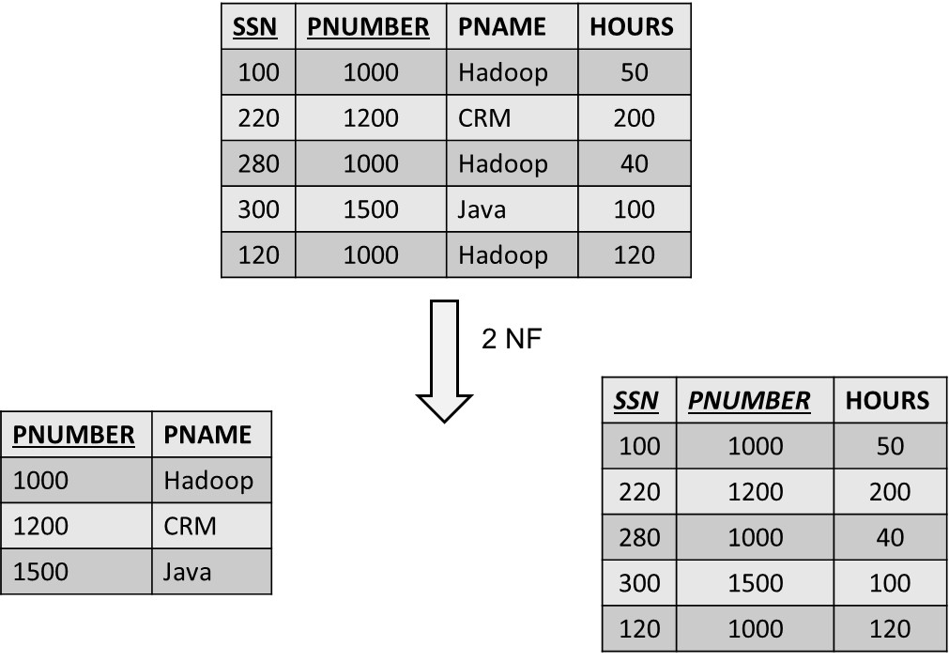
Second Normal Form (2 NF)

Slide 196
Third Normal Form (3 NF)
A functional dependency X → Y in a relation R is a transitive dependency if there is a set of attribute types Z that is neither a candidate key nor a subset of any key of R, and both X → Z and Z → Y hold
A relation is in the third normal form (3 NF) if it satisfies 2 NF and no non-prime attribute type of R is transitively dependent on the primary key
If the relation is not in third normal form, we need to decompose the relation R and set up a relation that includes the non-key attribute types that functionally determine the other non-key attribute types

Slide 197
Third Normal Form (3 NF)
R1(SSN, ENAME, DNUMBER, DNAME, DMGRSSN)
Assume an employee works in one department, a department can have multiple employees and a department has one manager
R11(SSN, ENAME, DNUMBER)
R12(DNUMBER, DNAME, DMGRSSN)

Slide 198
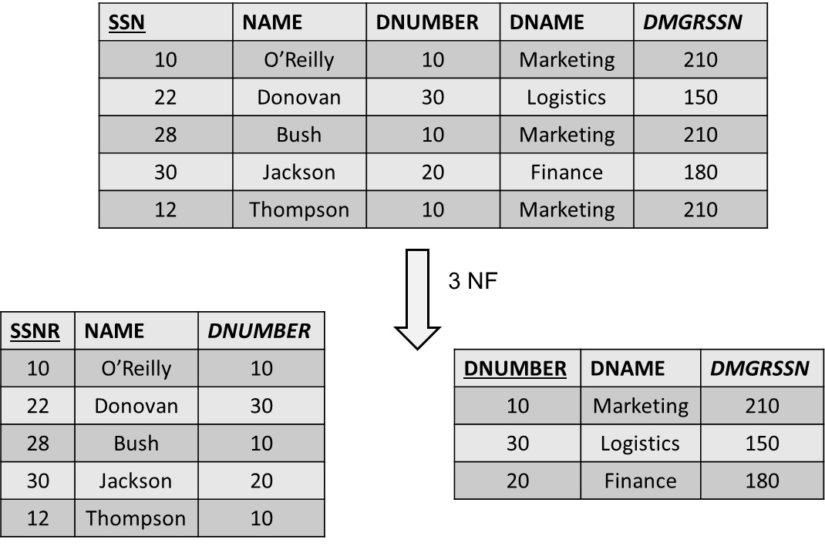
Third Normal Form (3 NF)

Slide 199
Boyce-Codd Normal Form (BCNF)
A functional dependency X → Y is called a trivial functional dependency if Y is a subset of X
Example: SSN, NAME → SSN
A relation R is in the Boyce-Codd normal form (BCNF) provided each of its non-trivial functional dependencies X → Y, X is a superkey—that is, X is either a candidate key or a superset thereof
BCNF normal form is stricter than the third normal form
Every relation in BCNF is also in 3 NF (not vice versa)

Slide 200
Boyce-Codd Normal Form (BCNF)
R1(SUPNR, SUPNAME, PRODNR, QUANTITY)
Assume a supplier can supply multiple products; a product can be supplied by multiple suppliers and a supplier has a unique name
R11(SUPNR, PRODNR, QUANTITY)
R12(SUPNR, SUPNAME)

Slide 201
Fourth Normal Form (4 NF)
There is a multivalued dependency from X to Y, X →→ Y, if and only if each X value exactly determines a set of Y values, independently of the other attribute types
A relation is in the fourth normal form (4 NF) if it is in Boyce-Codd normal form and for every one of its non-trivial multivalued dependencies X →→ Y, X is a superkey—that is, X is either a candidate key or a superset thereof

Slide 202
Fourth Normal Form (4 NF)
R1(course, instructor, textbook)
Assume a course can be taught by different instructors, and a course uses the same set of textbooks for each instructor
R11(course, textbook)
R12(course, instructor)

Slide 203
Fourth Normal Form (4 NF)

Slide 204
Mapping a Conceptual ER Model to a Relational Model
Mapping Entity Types
Mapping Relationship Types
Mapping Multivalued Attribute Types
Mapping Weak Entity Types
Putting it All Together

Slide 205
Mapping Entity Types
EMPLOYEE(SSN, address, first name, last name)
PROJECT(PNR, pname, pduration)

Slide 206
Mapping Relationship Types
Mapping a binary 1:1 relationship type
Mapping a binary 1:N relationship type
Mapping a binary M:N relationship type
Mapping unary relationship types
Mapping n-ary relationship types

Slide 207
Mapping a Binary 1:1 Relationship Type
Create two relations: one for each entity type participating in the relationship type
The connection can be made by including a foreign key in one of the relations to the primary key of the other
In case of existence dependency, put the foreign key in the existent dependent relation and declare it as NOT NULL
The attribute types of the 1:1 relationship type can then be added to the relation with the foreign key

Slide 208
Mapping a Binary 1:1 Relationship Type

Slide 209
Mapping a Binary 1:1 Relationship Type
EMPLOYEE(SSN, ename, address, DNR)
DEPARTMENT(DNR, dname, dlocation)

Slide 210
Mapping a Binary 1:1 Relationship Type
EMPLOYEE(SSN, ename, address)
DEPARTMENT(DNR, dname, dlocation, SSN)

Slide 211
Mapping a Binary 1:N Relationship Type
Binary 1:N relationship types can be mapped by including a foreign key in the relation corresponding to the participating entity type at the N-side of the relationship type
The foreign key refers to the primary key of the relation corresponding to the entity type at the 1-side of the relationship type
Depending upon the minimum cardinality, the foreign key can be declared as NOT NULL or NULL ALLOWED
The attribute types of the 1:N relationship type can be added to the relation corresponding to the participating entity type

Slide 212
Mapping a Binary 1:N Relationship Type
EMPLOYEE(SSN, ename, address, starting date, DNR)
DEPARTMENT(DNR, dname, dlocation)

Slide 213
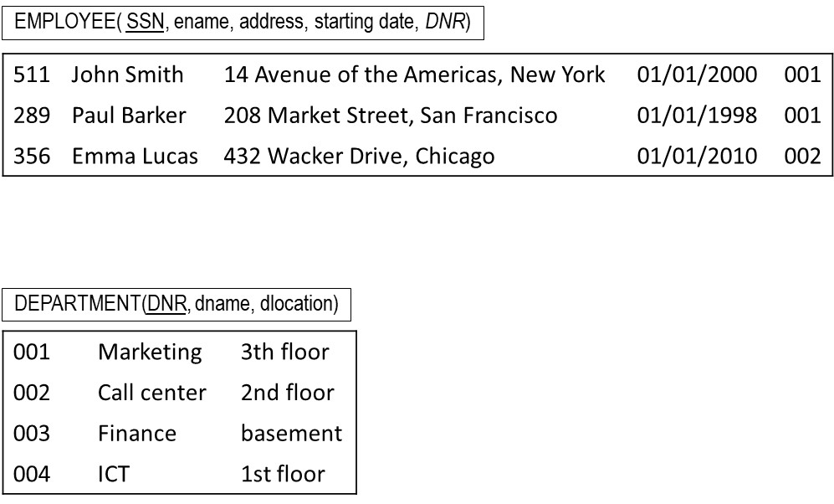
Mapping a Binary 1:N Relationship Type

Slide 214
Mapping a Binary N:M Relationship Type
M:N relationship types are mapped by introducing a new relation R
The primary key of R is a combination of foreign keys referring to the primary keys of the relations corresponding to the participating entity types
The attribute types of the M:N relationship type can also be added to R

Slide 215
Mapping a Binary M:N Relationship Type
EMPLOYEE(SSN, ename, address)
PROJECT(PNR, pname, pduration)
WORKS_ON(SSN, PNR, hours)

Slide 216
Mapping a Binary M:N Relationship Type

Slide 217
Mapping Unary Relationship Types
A recursive 1:1 or 1:N relationship type can be implemented by adding a foreign key referring to the primary key of the same relation
For a N:M recursive relationship type, a new relation R needs to be created with two NOT NULL foreign keys referring to the original relation

Slide 218
Mapping Unary Relationship Types
EMPLOYEE(SSN, ename, address, supervisor)

Slide 219
Mapping Unary Relationship Types

Slide 220
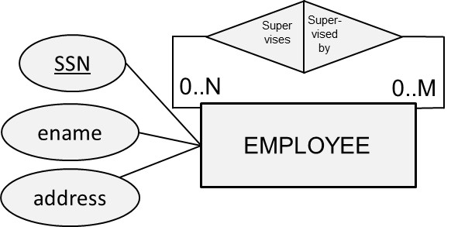
Mapping Unary Relationship Types
EMPLOYEE(SSN, ename, address)
SUPERVISION(Supervisor, Supervisee)

Slide 221
Mapping Unary Relationship Types

Slide 222
Mapping n-ary Relationship Types
To map an n-ary relationship type, we first create relations for each participating entity type
We then also define one additional relation R to represent the n-ary relationship type and add foreign keys referring to the primary keys of each of the relations corresponding to the participating entity types
The primary key of R is the combination of all foreign keys which are all NOT NULL
Any attribute type of the n-ary relationship can also be added to R

Slide 223
Mapping n-ary Relationship Types
TOURIST(TNR, …)
TRAV_AGENCY(ANR, …)
HOTEL(HNR, …)
BOOKING(TNR, ANR, HNR, price)

Slide 224
Mapping n-ary Relationship Types
INSTRUCTOR(INR, …)
COURSE(CNR, …)
SEMESTER(SEM-YEAR, …)
OFFERS(INR,CNR,SEM-YEAR)

Slide 225
Mapping n-ary Relationship Types

Slide 226
Mapping Multivalued Attribute Types
For each multivalued attribute type, we create a new relation R
We put the multivalued attribute type in R together with a foreign key referring to the primary key of the original relation
Multivalued composite attribute types are again decomposed into their components
The primary key can then be set based upon the assumptions

Slide 227
Mapping Multivalued Attribute Types
EMPLOYEE(SSN, ename, address)
EMP-PHONE(PhoneNr, SSN)

Slide 228
Mapping Multivalued Attribute Types

Slide 229
Mapping Weak Entity Types
A weak entity type should be mapped into a relation R with all its corresponding attribute types
A foreign key must be added referring to the primary key of the relation corresponding to the owner entity type
Because of the existence dependency, the foreign key is declared as NOT NULL
The primary key of R is then the combination of the partial key and the foreign key

Slide 230
Mapping Weak Entity Types
Hotel (HNR, Hname)
Room (RNR, HNR, beds)

Slide 231
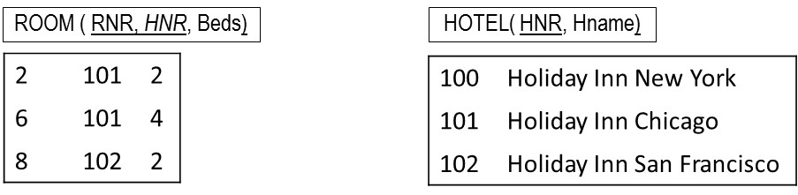
Mapping Weak Entity Types

Slide 232
Putting it All Together
ER Model | Relational model
Entity type | Relation
Weak entity type | Foreign key
1:1 or 1:N relationship type | Foreign key
M:N relationship type | New relation with two foreign keys
N-ary relationship type | New relation with N foreign keys
Simple attribute type | Attribute type
Composite attribute type | Component attribute type
Multivalued attribute type | Relation and foreign key
Key attribute type | Primary or alternative key

Slide 233
Putting it All Together
EMPLOYEE(SSN, ename, streetaddress, city, sex, dateofbirth, MNR, DNR)
MNR foreign key refers to SSN in EMPLOYEE, NULL ALLOWED
DNR foreign key refers to DNR in DEPARTMENT, NOT NULL
DEPARTMENT (DNR, dname, dlocation, MGNR)
MGNR: foreign key refers to SSN in EMPLOYEE, NOT NULL
PROJECT (PNR, pname, pduration, DNR)
DNR: foreign key refers to DNR in DEPARTMENT, NOT NULL
WORKS-ON (SSN, PNR, HOURS)
SSN foreign key refers to SSN in EMPLOYEE, NOT NULL
PNR foreign key refers to PNR in PROJECT, NOT NULL

Slide 234
Mapping a Conceptual EER Model to a Relational Model
Mapping an EER specialization
Mapping an EER categorization
Mapping an EER aggregation

Slide 235
Mapping an EER Specialization
3 options:
Create a relation for the superclass and each subclass and link them with foreign keys
Create a relation for each subclass and none for the superclass
Create one relation with all attribute types of the superclass and subclasses and add a special attribute type

Slide 236
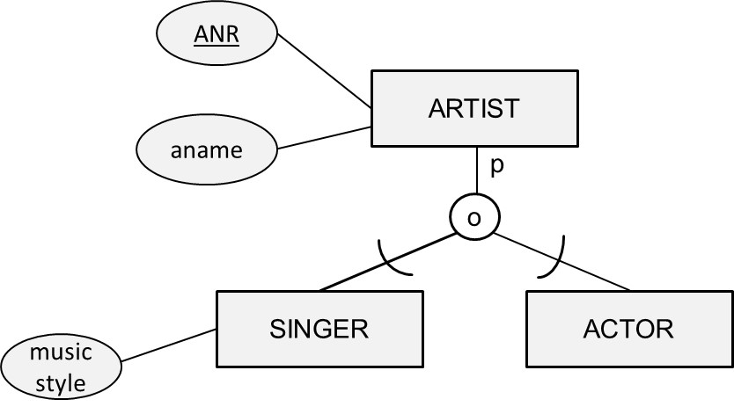
Mapping an EER Specialization
ARTIST(ANR, aname, …)
SINGER(ANR, music style, …)
ACTOR(ANR, …)

Slide 237
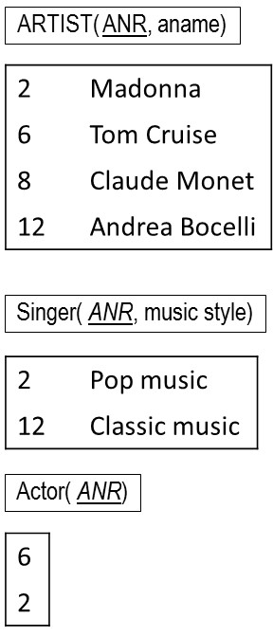
Mapping an EER Specialization

Slide 238
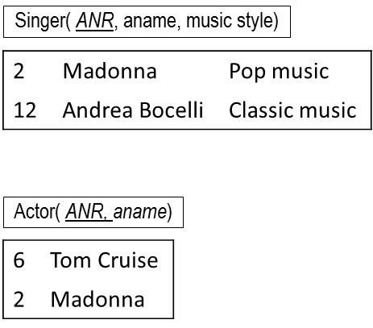
Mapping an EER Specialization
SINGER(ANR, aname, music style, …)
ACTOR(ANR, aname, …)

Slide 239
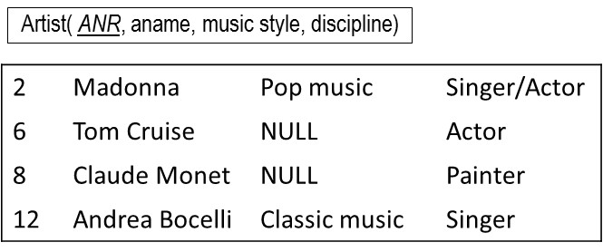
Mapping an EER Specialization
ARTIST(ANR, aname, music style, …, discipline)

Slide 240
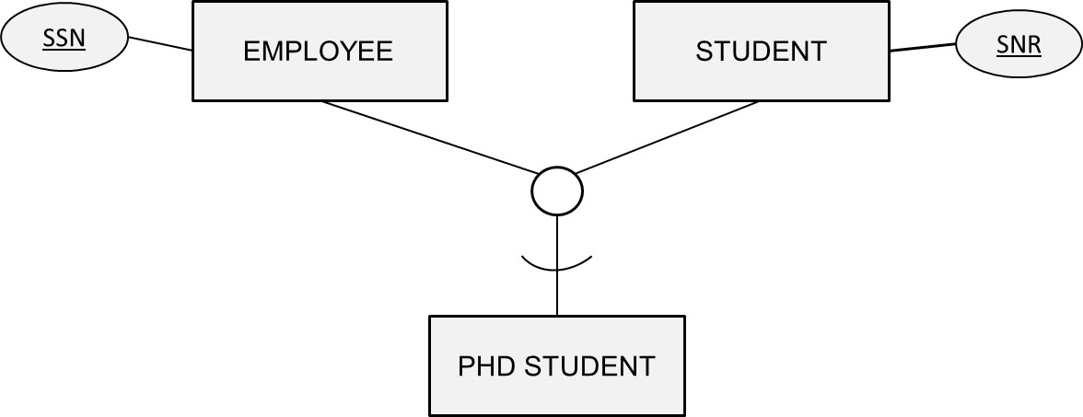
Mapping an EER Specialization
EMPLOYEE(SSN, …)
STUDENT(SNR, …)
PHD-STUDENT(SSN, SNR, …)

Slide 241

Mapping an EER Categorization
PERSON(PNR, …, CustNo)
COMPANY(CNR, …, CustNo)
ACCOUNT-HOLDER(CustNo, …)

Slide 242
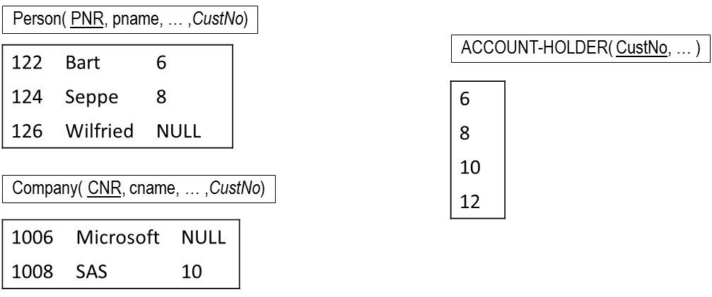
Mapping an EER Categorization

Slide 243
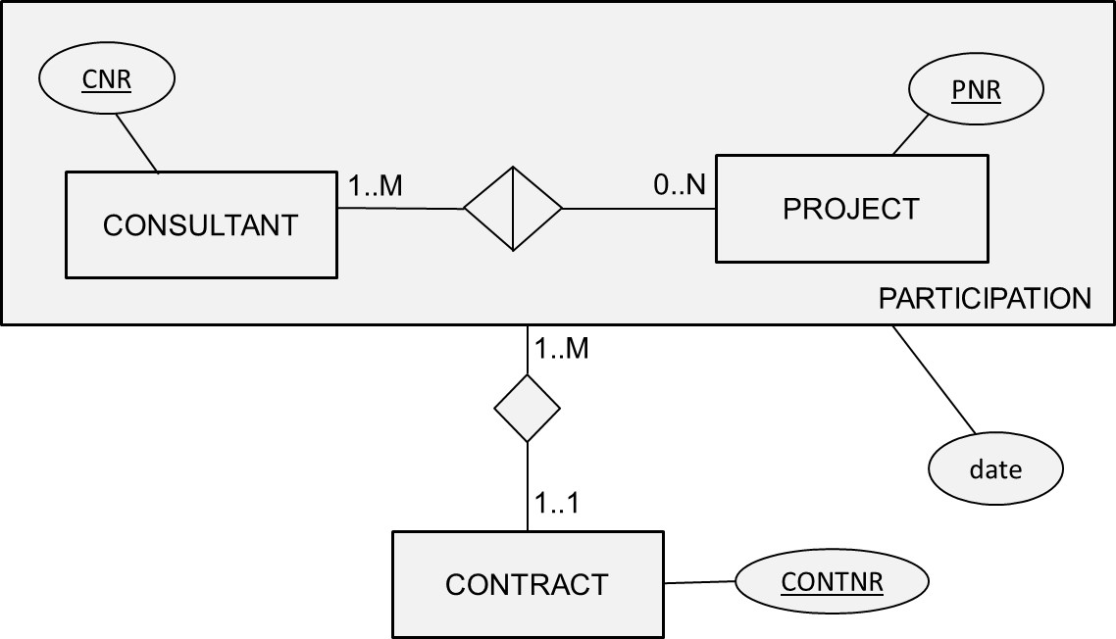
Mapping an EER Aggregation
CONSULTANT(CNR, …)
PROJECT(PNR, …)
PARTICIPATION(CNR, PNR, CONTNR, date)
CONTRACT(CONTNR, …)

Slide 244
Conclusions
Relational Model
Normalization
Mapping a conceptual ER model to a relational model
Mapping a conceptual EER model to a relational model

Slide 245
More information?
www.pdbmbook.com

